Slide 1
The Normal Curve

Slide 2
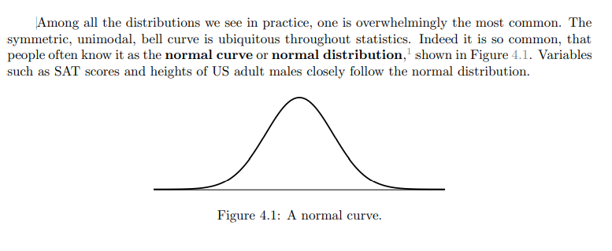
A bell-shaped curve, which is symmetrical
mean = median = mode
the values cluster around the middle; there are very few more than 3 standard deviations away from the mean

Slide 3

Z scores
Definition: how many standard deviations an individual is away from the mean
Formula:
for an observation x that follows a distribution
with mean µ and standard deviation σ

Slide 4
Example
Let X represent a random variable from N(µ = 3, σ = 2), and suppose we observe x = 5.19.
Find the Z-score of x.
Use the Z-score to determine how many standard deviations above or below the mean x falls.
if x < μ, the z-score is negative
if x>μ, the z-score is positive
if x = μ, the z-score is 0

Slide 5
Example: A flashlight battery has a mean life of 40 hours and a standard deviation of 5 hours. Find the z-score of a battery that lasts:
5 hours
35 hours
40 hours
if x < μ, the z-score is negative
if x>μ, the z-score is positive
if x = μ, the z-score is 0

Slide 6
Example:
In a distribution of scores with a mean of 40 and standard deviation of 4, one individual has a z-score of -1.2.
How many points did they score?

Slide 7
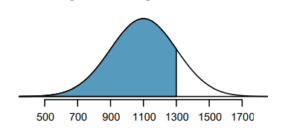
What fraction of people have an SAT score below Ann’s score of 1300? This is the same as the percentile Ann is at, which is the percentage of cases that have lower scores than Ann.
We can visualize such a tail area like the curve and shading shown in Figure 4.6.
The area to the left of Z represents the fraction of people who scored lower than Ann.

Slide 8
Find z score
Insert into computer or table to find the lower tail area
Z score: 1300-1100/200 =1
(Note how to find the mean and the standard deviation from the diagram)
Checking z=1 in tables/computer gives 0.8413, the fraction of people that have lower scores than Ann.

Slide 9
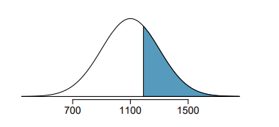
Cumulative SAT scores are approximated well by a normal model, N(µ = 1100, σ = 200).
Shannon is a randomly selected SAT taker, and nothing is known about Shannon’s SAT aptitude. What is the probability Shannon scores at least 1190 on her SATs?
First, always draw and label a picture of the normal distribution!
We are interested in the chance she scores above 1190, so we shade this upper tail:

Slide 10

Find the z score
Insert in computer/check table to find area
Area below z is found to be 0.6736.

Slide 11

3. To find the area above z,
1 – 0.6736 = 0.3264

Slide 12
Remember:
stats.norm.ppf takes a percentage and gives the z-score of the upper limit (on the top)
stats.norm.cdf takes a z-score and gives the percentage less than (to the left of) that z-score
the formula allows us to calculate a z-score based on an x (value, data, score) and to calculate an x based on a z-score.
Draw a picture for every exercise!

Slide 13
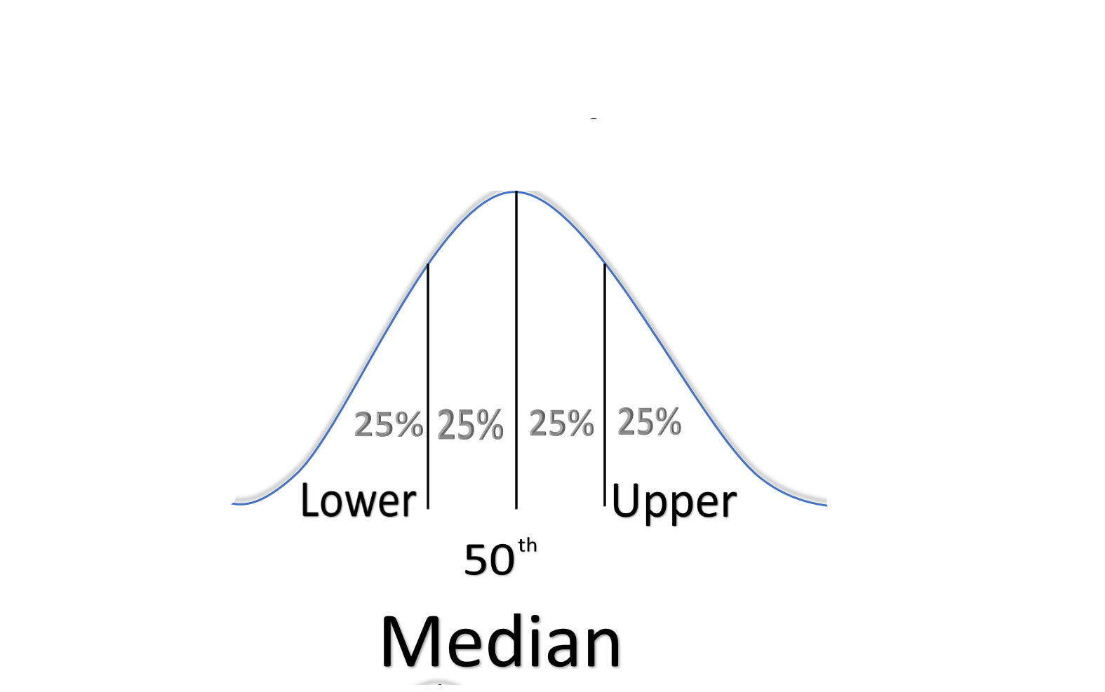

Slide 14
Open a jupyter notebook and let’s practice!
Find the percent less than z=0
Find the percent less then z=-1
Find the percent more than z=-1
Find the percent less than z=-3
Find the percent more than z=-3
Find the percent between z=0 and z=1
Find the percent between z=0 and z=-1.15
Find the percent between z=-1.63 and z=2.2
Find the percent less than z=0.43
Find the percent greater than -2.47.
Find the percent greater than 1.82

